Slide 1

Introduction to Systems Biology:
The employment of systems biology in treatment of diseases
Prof Adil Mardinoglu
King’s College London
KTH-Royal Institute of Technology
http://sysmedicine.com

Slide 2
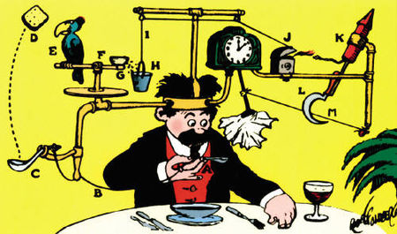
Systems Biology & Systems Medicine
Evolution created enormously complicated organisms and this random and chaotic process only work in particular environment.
Over the years complicated circuits are built on top of this complex structure.
To study and understand this complexity is a challenging task.
Rube Golberg’s inventions
Number of components
Individual dynamics
Their connection
System dynamics
2

Slide 3
Integration of omics data

Slide 4
GEMs: Genome-scale metabolic models
Tools for integration of omics data
Reactions
Genes
Stochiometric matrix
Glucose
ATP[c]
GCK
ADP[c]
R₁
R₂
R₃
R₄
R₅
R₆
G6P
Glucose
G6P
F6P
F16BP
GAP
13BPG
3PG
DHAP
ATP
ADP
NAD+
NADH
Pi
H+
S
-1
1
0
0
0
0
0
0
-1
1
0
0
0
0
0
-1
10000000000
0
00
-1
1
0000
-1
1000
0
000
-1
1001000000
0000
-1
0000
0
-1
1
-1
1
00000
-1
10
-1
1
0000
GPI
F6P
Network dependent
Analysis
ATP[c]
PFK
ADP[c]
F16BP
ALDO
DHAP[c]
TPI
GAP
NAD+[c], Pi[c]
GAPDH
Model
Simulations
NADH[c], H+[c]
13BPG
ATP[c]
PGK
Mardinoglu & Nielsen (2012), J Intern Med, 271: 142–154
Mardinoglu et al (2013), Biotechnol J, 8: 985-996
Mardinoglu & Nielsen (2015), COB, 34: 91–97
ADP[c]
3PG
4

Slide 5
Uhlen et. al (2015), Science, 347: 1260419

Slide 6
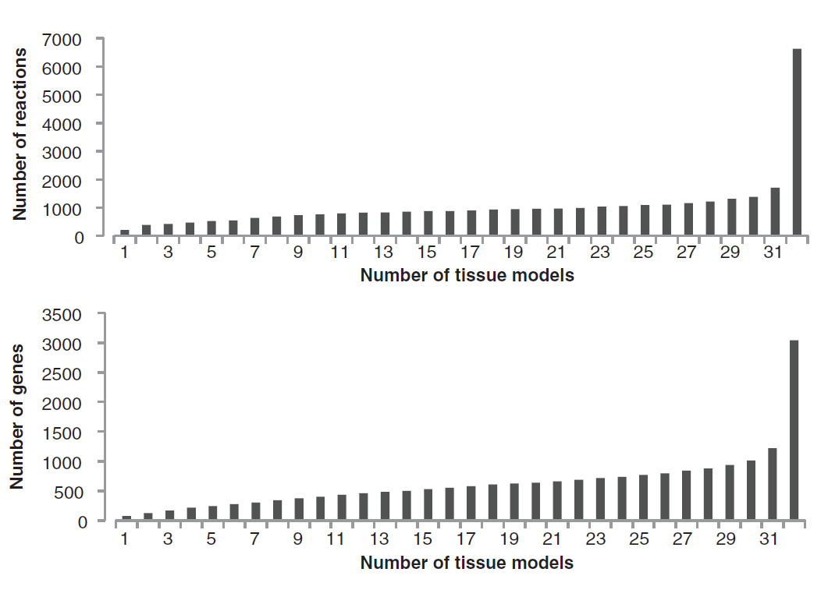
Human Tissue GEMs based on
proteomics and transcriptomics data
Uhlen et. al (2015), Science, 347: 1260419

Slide 7
Integration of GEMs with other biological networks
Lee et. al (2016), Cell Metabolism, 24, 172-184
Lee et. al (2016), Nucleic Acids Research, 44, 5529-5539
Mardinoglu et. al (2018), Nature Reviews Gast & Hep, in press

Slide 8
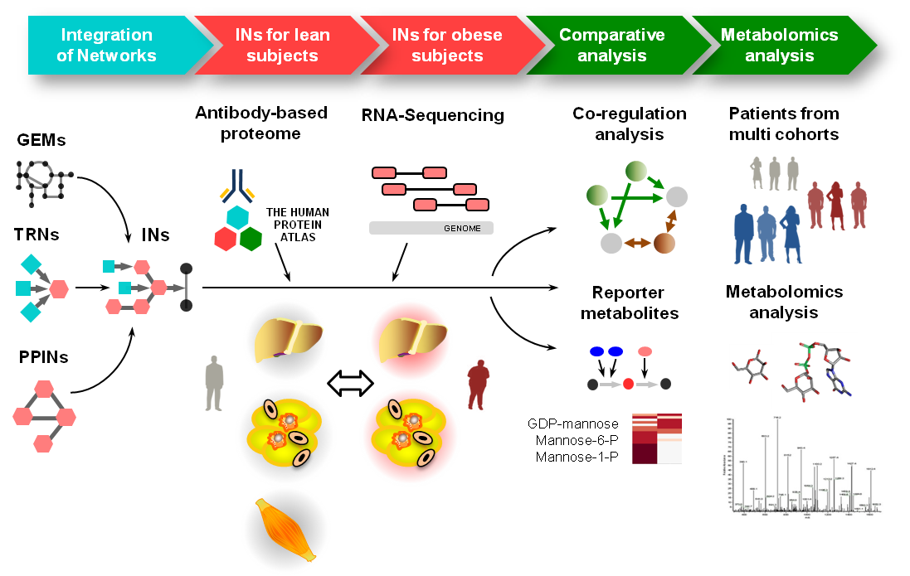
Mannose is identified as a marker of Insulin Resistance
Lee et. al (2016), Cell Metabolism, 24, 172-184
8

Slide 9
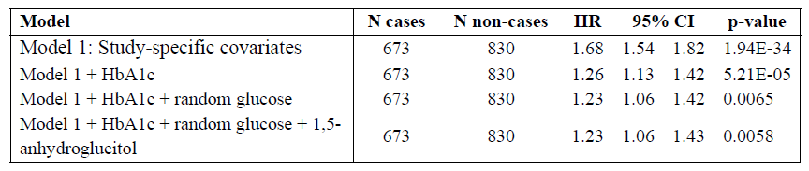
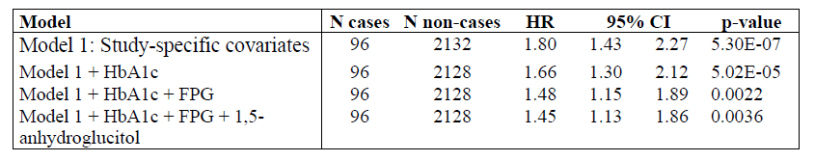
Association of mannose levels and incident T2D in 4,000 well phenotyped subjects
The EPIC-Norfolk STUDY
METSIM STUDY
Mardinoglu et. al (2017), Cell Metabolism, 26, 281-283

Slide 10


Applications of GEMs in
medical applications
Whole body simulations
Omics data analysis
Genome-scale metabolic models
Molecular mechanisms
Obesity
Therapeutic agents
Drug targets
Novel biomarkers
NAFLD
HCC
T2D
PERSONALIZED AND TRANSLATIONAL MEDICINE
Mardinoglu et. al (2013), Mol Syst Biol, 9: 649
Mardinoglu et. al (2015), Sci. Rep, 5:14841
Mardinoglu et. al (2015), J Proteome Res, 13:5106-5119
Mardinoglu et. al (2014), Nature Commun, 5: 3083
Kampf & Mardinoglu et. al (2014), Faseb J, 28: 2901
Varemo et. al (2015), Cell Rep, 11: 921-933

Slide 11
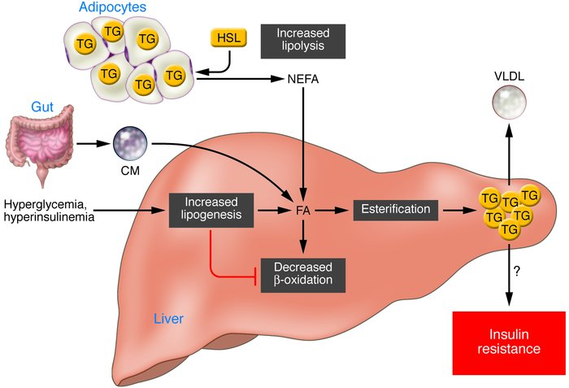
NAFLD
Increased Fat synthesis, DNL
Increased Fat uptake
Decreased Fat oxidation
Decreased VLDL Secretion
11

Slide 12
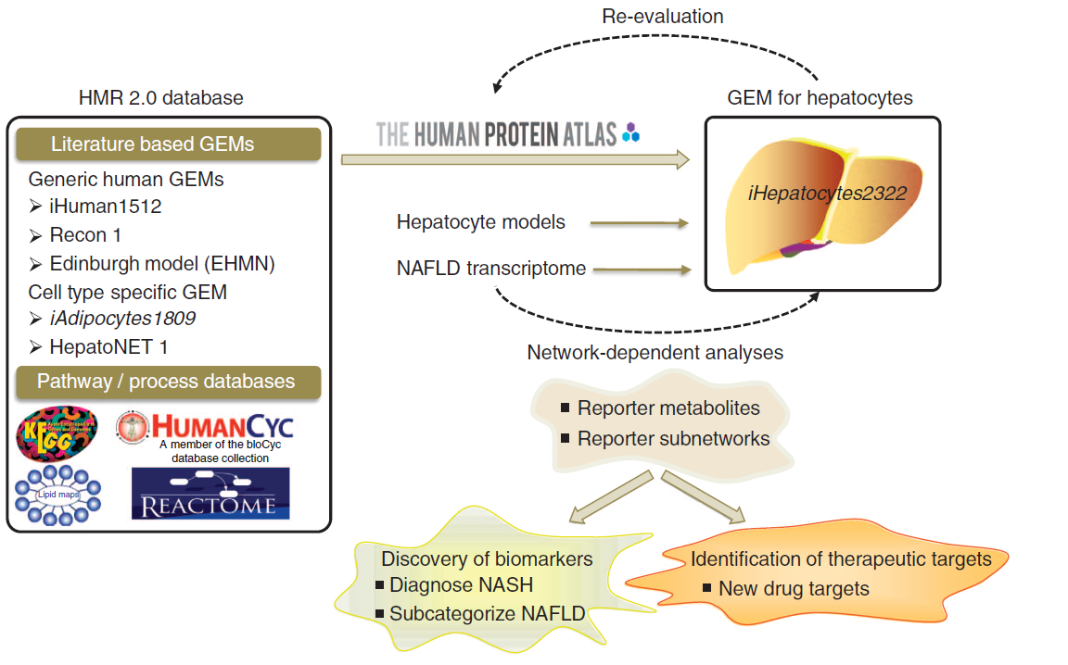
Functional Hepatocyte Model, iHepatocytes2322
Mardinoglu et. al (2014), Nat Commun, 5: 3083

Slide 13
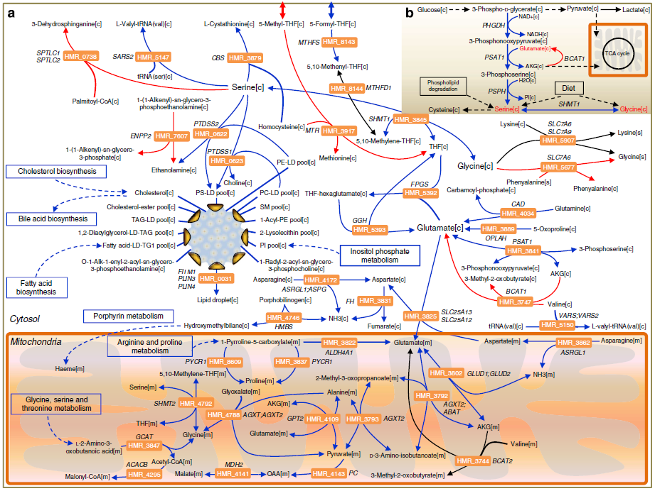
Metabolic differences in NASH
Mardinoglu et. al (2014), Nat Commun, 5: 3083

Slide 14

Subjects with NAFLD
(N = 86)
In total 20 h (fasting conditions throughout experiment)
T=0h
T=4h
T=8h
12 h (overnight)
4 h
4 h
Study subjects with
increased cardiovascular risk
d3-leucine and d5-glycerol
injection for VLDL kinetics
Blood samples
﻿Juste den det bli dålig
T = 0h, 4h, 8h
T = 4h
T = 8h
Blood samples for
VLDL / apoB kinetics
Durham
Metabolomics
Sacramento
Lipidomics
(N = 73)
(N = 86)
(N = 78)
VLDL kinetics
Plasma Metabolomics
Plasma
Lipidomics
Mardinoglu et. al (2017), Mol. Syst. Bio., 13:916

Slide 15
Simulation of liver tissue metabolism
15
Mardinoglu et. al (2017), Mol. Syst. Bio., 13:916

Slide 16
Correlation of intracellular fluxes
with liver fat
Liver tissue
glucose[c]
3-phospho-D-glycerate[c]
pyruvate[c]
lactate[c]
PHGDH
NAD+[c]
NADH[c]
3-phosphonooxypyruvate[c]
PSAT1
glutamate[c]
BCAT1
TCA Cycle
AKG[c]
3-phosphoserine[c]
H2O[c]
PSPH
Pi[c]
Serine
Glycine
Betaine
Nacetylglycine
ADP[c]
Pi
Glycine[c]
SHMT1
serine[c]
ATP[c]
Glutamine[c]
Glutamate[c]
gamma-glutamyl-
cysteine[c]
GSH[c]
GCLC
GCLM
GSS
ATP[c]
ADP[c]
Pi
Cysteine[c]
NADH[m]
Mitochondria
NNT
NADP+[m]
2 GSH[m]
H2O2[m]
H+[c]
MMR_4271
H+[m]
GSR
MMR_3870
MMR_4121
CAT
NADPH[m]
2 H2O[m]
O2[m]
Blood
GSSG[m]
Cytoplasm
NAD+[m]
Blue colour indicates down regulation of the genes.
16
Mardinoglu et. al (2017), Mol. Syst. Bio., 13:916

Slide 17
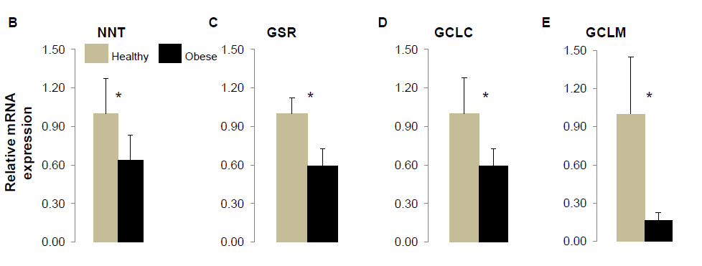
Expression of genes in subjects
with high liver fat
Mardinoglu et. al (2017), Mol. Syst. Bio., 13:916

Slide 18
Human serine supplementation for
two weeks
ALT
C
AST
D
ALP
E
TGs
 | Before |  |  | After
U/L
Patients
Patients
Patients
Patients
Mardinoglu et. al (2017), Mol. Syst. Bio., 13:916
18

Slide 19
Human serine supplementation
for two weeks
Clinical variable | Baseline n=6 | After serine n=6 | P-value
Liver fat (%) | 26.8 ± 6.0 | 20.4 ± 7.0 | <0.05
Age (years) | 56.7 ± 5.2 | 56.7 ± 5.2 | -
Weight (kg) | 103.0 ± 14.3 | 103.0 ± 13.9 | -
Body Mass Index (BMI) (kg/m²) | 32.5 ± 2.70 | 32.5 ± 2.60 | -
Alanine aminotransferase (ALT) (U/L) | 50.8 ± 15.2 | 37.6 ± 5.3 | <0.05
Aspartate aminotransferase (AST) (U/L) | 34.5 ± 8.10 | 27.4 ± 8.4 | <0.05
Alkaline phosphatase (ALP) (U/L) | 76.3 ± 17.2 | 71.3 ± 17.9 | <0.05
γ -Glutamyl transferase (μGT) (U/L) | 63.8 ± 12.9 | 62.3 ± 16.3 | 0.30
Fasting plasma glucose (mmol/L) | 6.57 ± 1.41 | 6.33 ± 1.41 | 0.25
Fasting plasma insulin (FPI) (pmol/L) | 46.3 ± 33.8 | 34.7 ± 25.2 | 0.23
HOMA-IR | 2.15 ± 1.85 | 1.54 ± 1.49 | 0.18
LDL cholesterol (mmol/L) | 3.68 ± 0.80 | 3.85 ± 0.94 | 0.50
HDL cholesterol (mmol/L) | 1.00 ± 0.21 | 1.02 ± 0.18 | 0.30
Plasma triglycerides (TG) (mmol/L) | 6.90 ± 6.65 | 3.63 ± 1.81 | 0.13
Total cholesterol (mmol/L) | 6.23 ± 1.49 | 5.85 ± 1.15 | 0.18
Bilirubin (μmol/L) | 7.33 ± 4.11 | 6.48 ± 3.94 | 0.13
Mardinoglu et. al (2017), Mol. Syst. Bio., 13:916

Slide 20
Human cocktail supplementation
for six weeks
Mardinoglu et. al (2017), Mol. Syst. Bio., 13:916

Slide 21
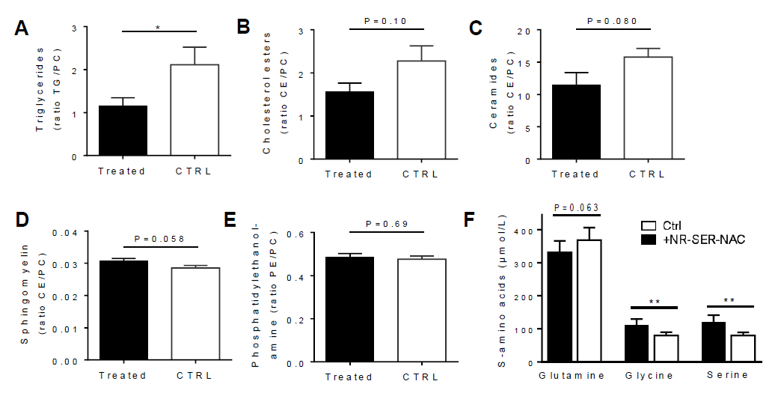
Mouse cocktail supplementation for
two weeks
Twenty male C57BL/6N mice were fed a standard mouse chow diet. From the age of 8 weeks mice were fed a Western diet by separating in to two groups. After 14 days one group of mice were treated with: NR 400mg/kg, Serine 300mg/kg a day la gavage and 1g/l of NAC (N-acetyl-L-cysteine) in the drinking water for 14 days.
Mardinoglu et. al (2017), Mol. Syst. Bio., 13:916

Slide 22
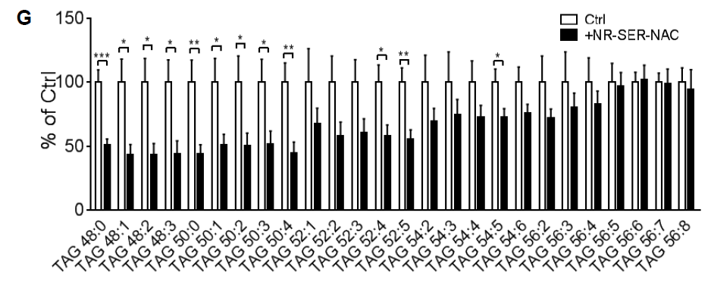
Mouse cocktail supplementation for
two weeks
Mardinoglu et. al (2017), Mol. Syst. Bio., 13:916

Slide 23
One day calibration study with cocktail
(N = 10)
20 g serine
3 g L-carnitine
5 g NAC
1 g NR
Breakfast | Sample at T0 | Sample at T1 | Sample at T2 | Sample at T3 | Sample at T4 | Sample at T5 | Sample at T6 | Sample at T7
7:00 | 8:00 | 9:00 | 10:00 | 11:00 | 12:00 | 13:00 | 14:00 | 15:30
Zhang et. al (2018), under review

Slide 24
Plasma level of fatty liver markers
Zhang et. al (2018), under review

Slide 25
Plasma level of BCAAs, markers of IR
Zhang et. al (2018), under review
22

Slide 26
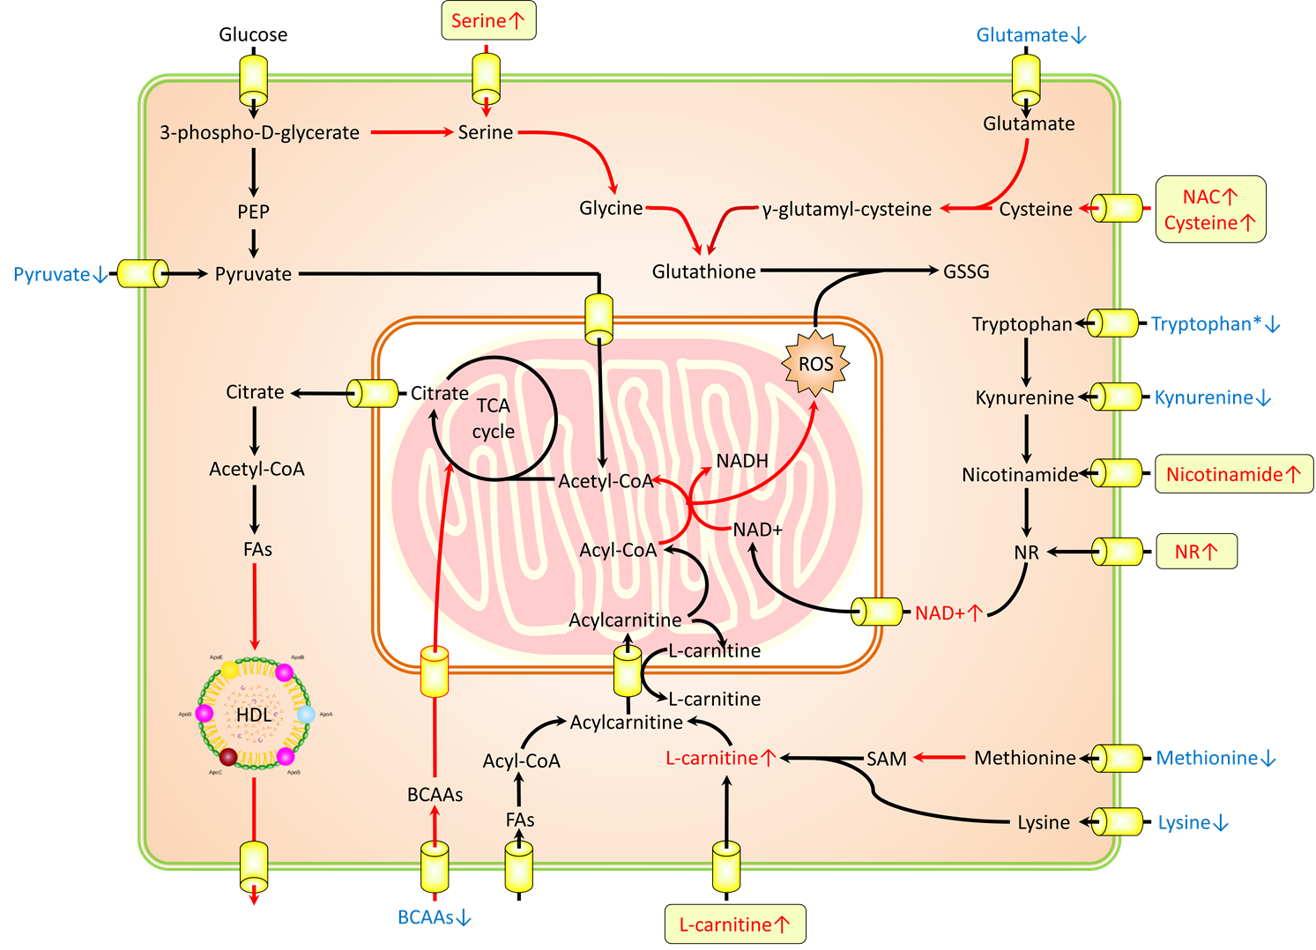
Effect of formulation in liver
Zhang et. al (2018), under review

Slide 27
Timeline for clinical studies
2017
2018
2019
Q1
Q4
Q2
Q3
Q4
Q1
Q2
Q3
Q1
Q2
Q3
Q4
Calib. study
GMP level formulation
Phase 2
Finland
Sweden
Turkey
South Korea
Phase 3

Slide 28
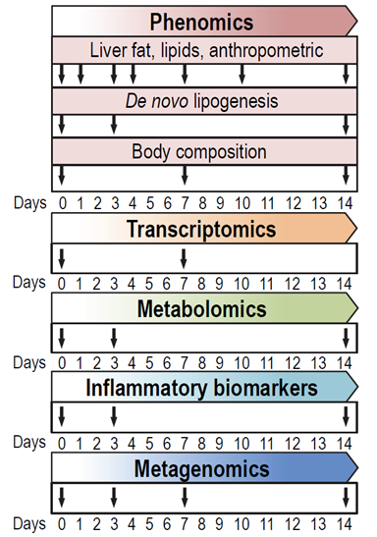
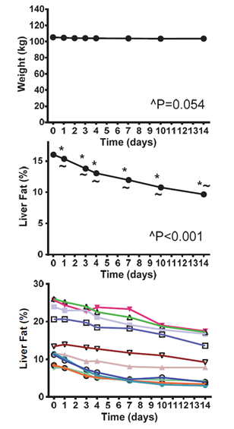
Isocaloric carbohydrate-restricted diet in subjects with NAFLD
Mardinoglu et. al (2018), Cell metabolism, 27: 559-571

Slide 29
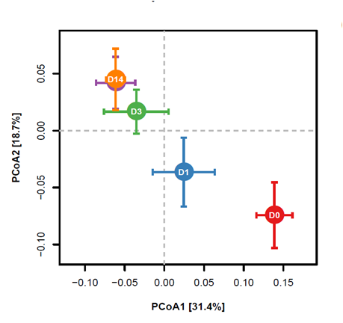
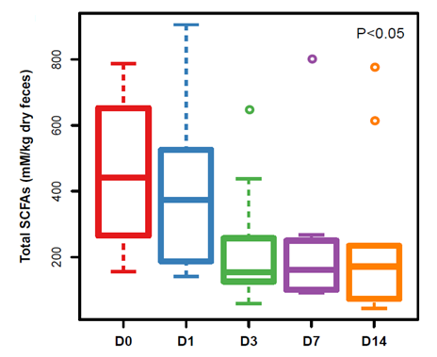
Rapid shift in microbiome
Mardinoglu et. al (2018), Cell metabolism, 27: 559-571

Slide 30
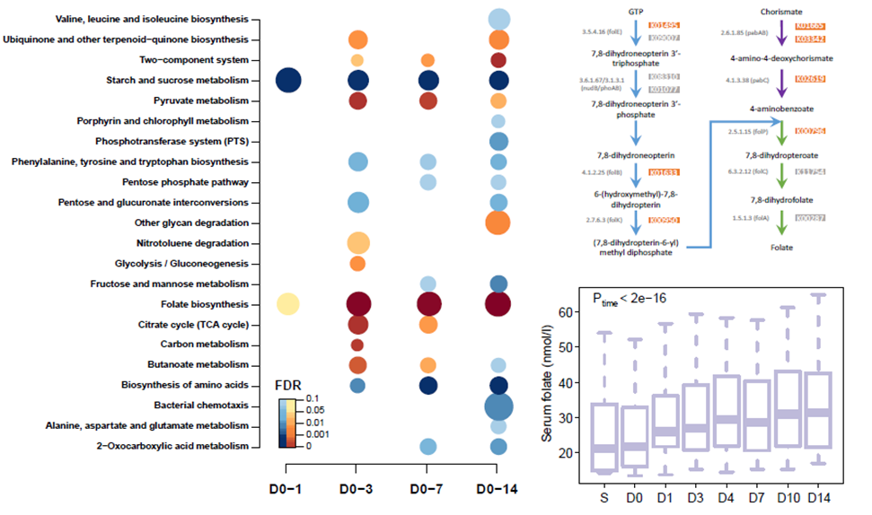
Rapid shift in microbiome
Mardinoglu et. al (2018), Cell metabolism, 27: 559-571

Slide 31
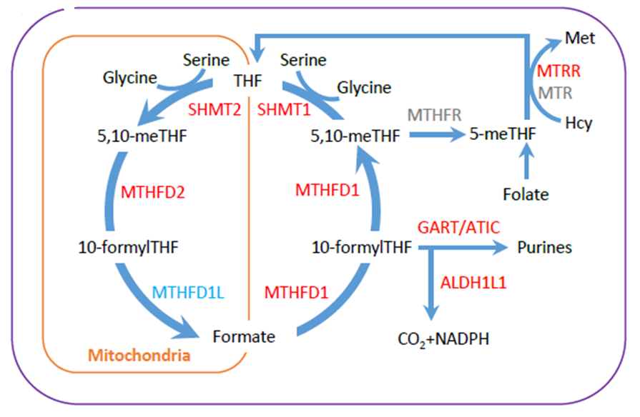
Reactions involved in liver folate metabolism
Mardinoglu et. al (2018), Cell metabolism, 27: 559-571

Slide 32
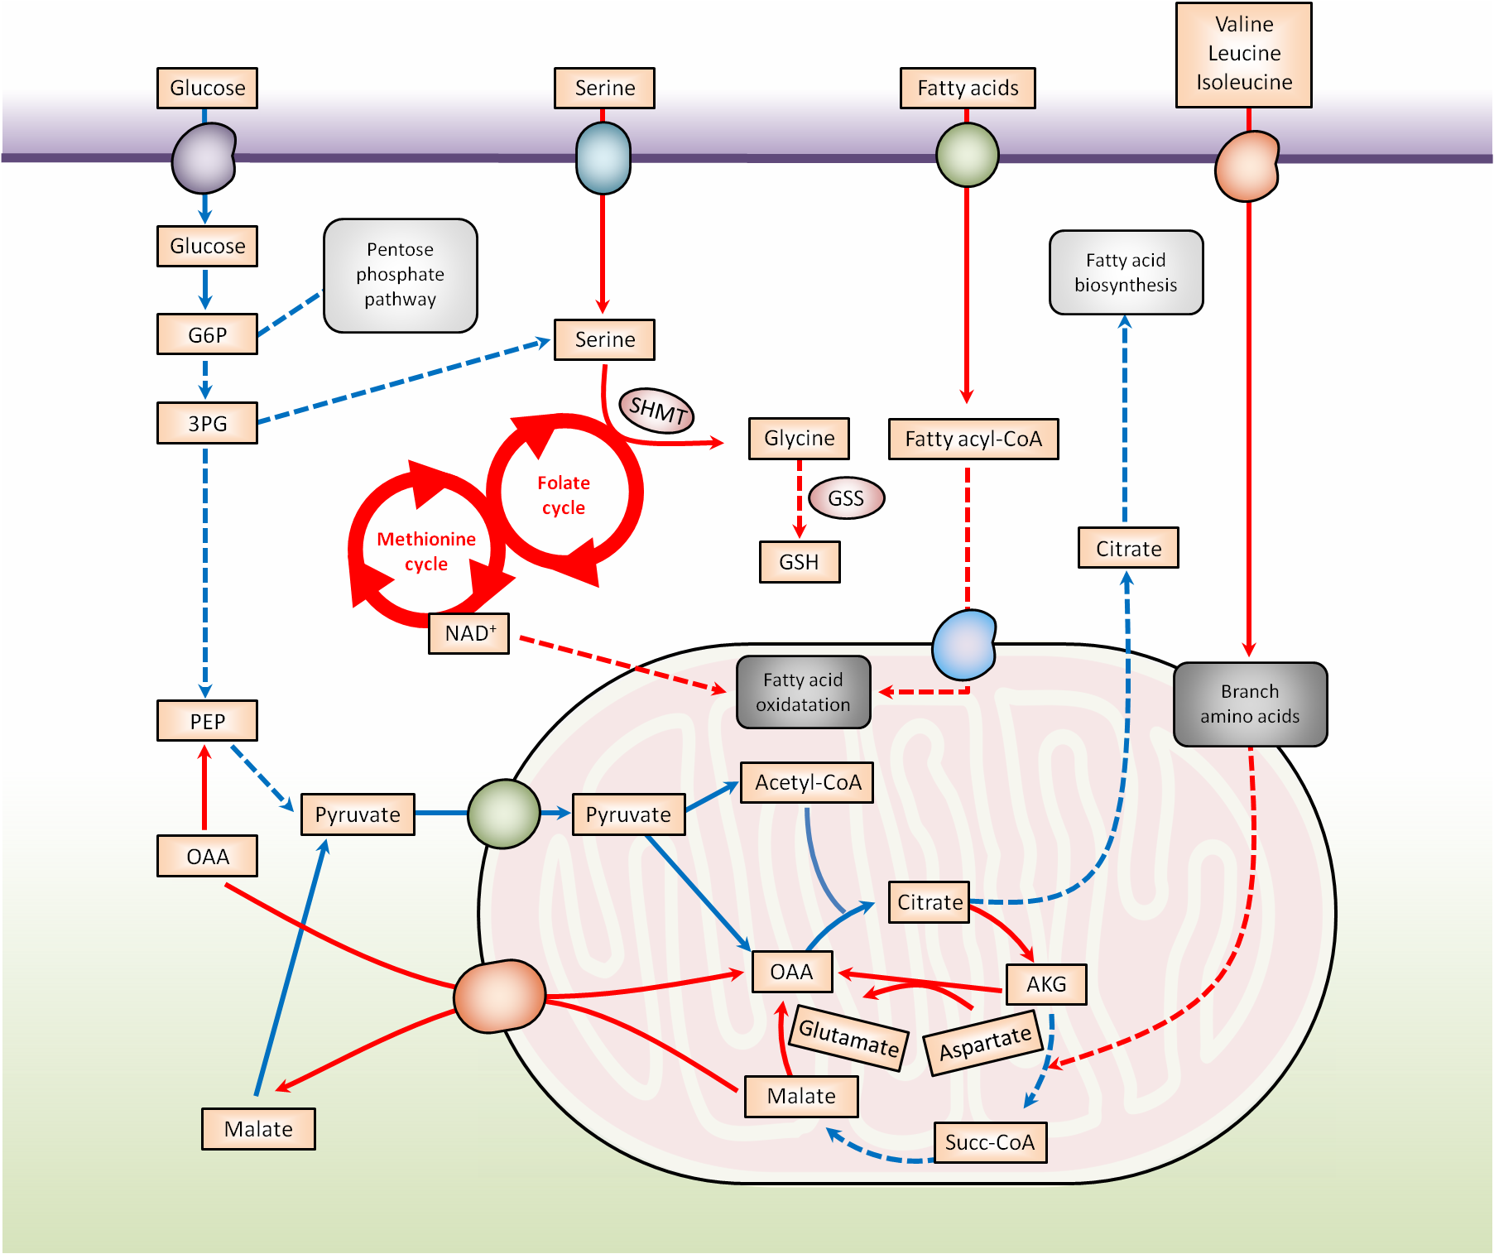
Global metabolic changes in liver
Mardinoglu et. al (2018), Cell metabolism, 27: 559-571

Slide 33
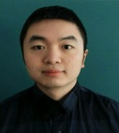
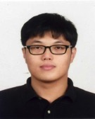
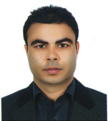
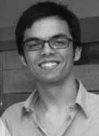
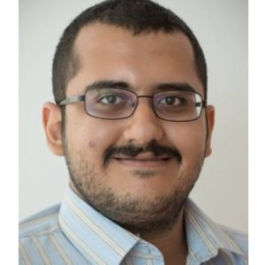
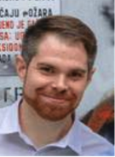
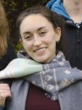
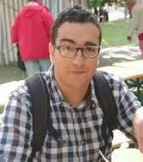
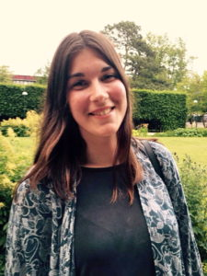
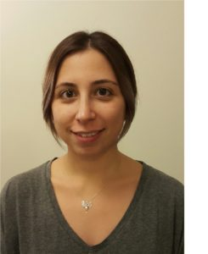
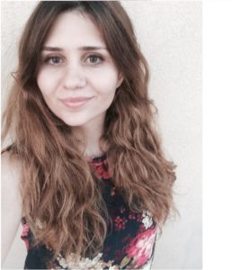
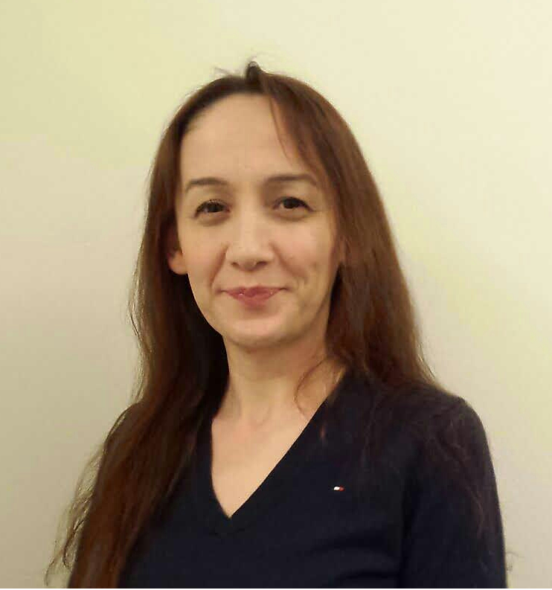
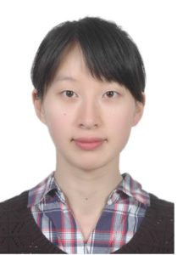
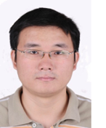
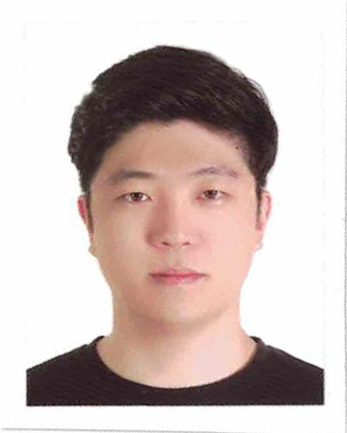
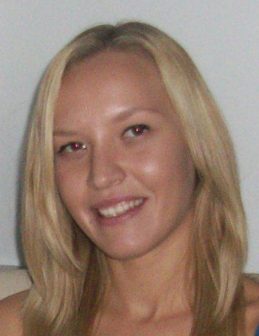
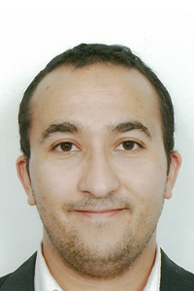
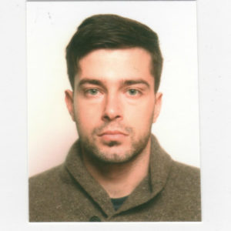
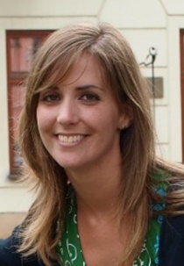
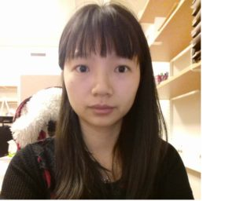
Systems medicine group@ SciLifeLab
Computational Biology
Cheng Zhang
Senior Researcher
Sunjae Lee
Senior Researcher
Ida Larsson
MSc Student
Reza Bidkhori
Post doc
Rui Benfeitas
Post doc
Muhammad Arif
PhD stud.
Alen Lovric
Research Eng
Dorines Rosario
Research Eng
Mohamed Alshobky
MSc Student
Experimental Biology
Beste Turanli
Vis Student
Feride Eren
Vis Student
Ozlem Altay
Vis Resarcher
Shuqi Zhang
Vis Resarcher
Zhengtao Liu
Post doc
Woong Hee Kim
Post doc
Natasa Sikanic
Researcher
Medicinal Chemistry
Computational Chemistry
Faddy Aziz
Post doc
Umberto Battisti
Post doc
Chiara Zagni
Post doc
Anders Füchtbauer
Post doc
Leticia Gómez
Post doc
Chunxia Gao
Post doc

Slide 34
Acknowledgements
SciLifeLab
Prof. Mathias Uhlen
Ass. Prof. Emma Lundberg
Ass. Prof. Simon Elsässer
Chalmers University of Technology
Prof. Jens Nielsen
University of Groningen
Albert K. Groen
University of Gothenburg
Prof Jan Boren
Prof Ulf Smith
Prof. Fredrik Bäckhed
Prof. Lena M Carlsson
Prof. Stefano Romeo
Prof. Morten Grötli
Prof. Leif Eriksson
University of Amsterdam
Mireille J. Serlie
King's College London
Ass. Prof. Saeed Shoaie
Stanford University
Prof. Michael Snyder
Dr Brian D Piening
NIH
Prof. George Kunos
Dr Resat Cinar
Bani Mukhopadhyay
Helsinki University
Prof Marja-Riitta Taskinen
Imperial College London
Prof. Philippe Froguel
Prof. Andrew J Walley
University of Leipzig
Prof. Matthias Blüher

Slide 35






Acknowledgements
35

